Slide 1
Backpropagation
CSCI 4360/6360 Data Science II

Slide 2
Artificial Neural Networks
Not a new concept!
Roots as far back as 1940s work in unsupervised learning
Took off in 1980s and 1990s
Waned in 2000s
“Biologically-inspired” computing
May or may not be true
Shift from rule-based to emergent learning
1986 paper by Rumelhart et al—fastest backpropagation algorithm since original 1970s version

Slide 3
Multilayer networks
Simplest case: classifier is a multilayer network of logistic units
Each unit takes some inputs and produces one output using a logistic classifier
Output of one unit can be the input of other units

Slide 4
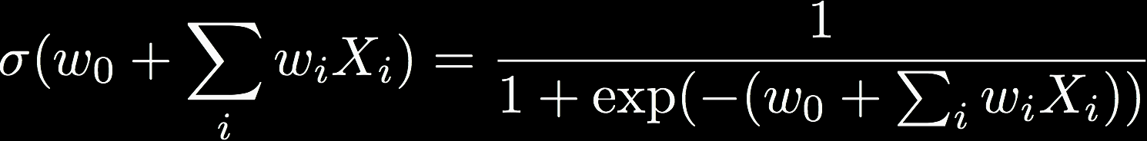
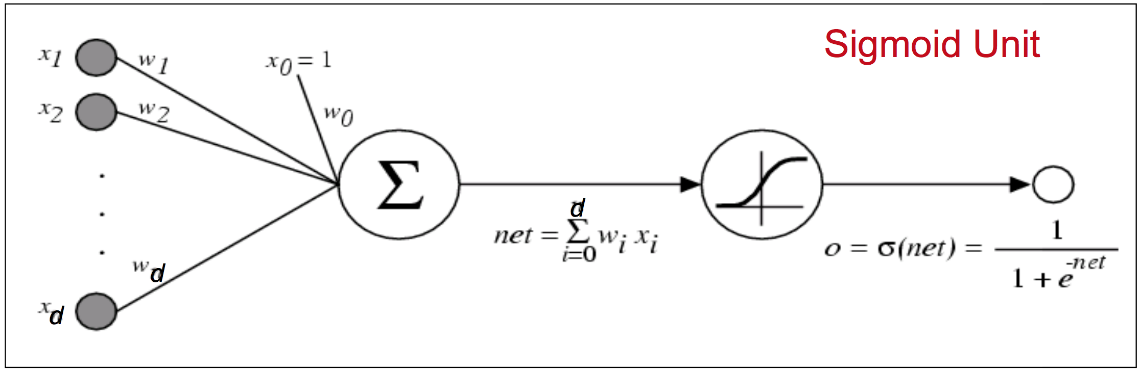
LR as a Graph
Define output o(x) =

Slide 5
Multilayer networks
Simplest case: classifier is a multilayer network of logistic units that perform some differentiable computation
Each unit takes some inputs and produces one output using a logistic classifier
Output of one unit can be the input of other units

Slide 6
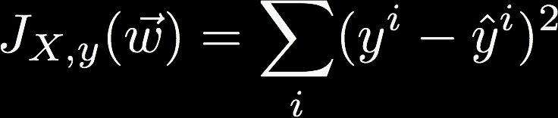
Learning a multilayer network
Define a loss (simplest case: squared error)
But over a network of “units” that do simple computations
Minimize loss with gradient descent
You can do this over complex networks if you can take the gradient of each unit: every computation is differentiable

Slide 7
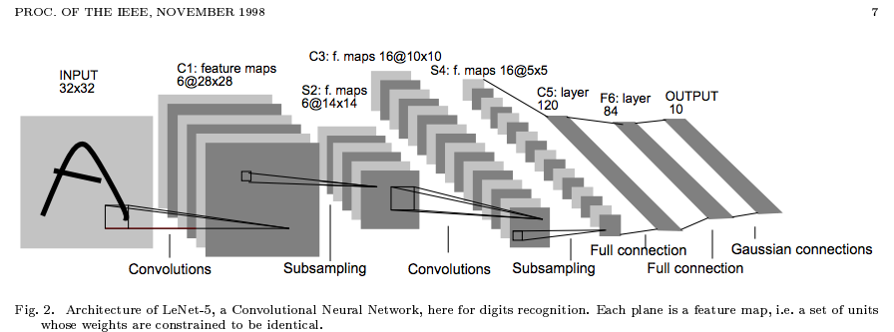
ANNs in the 90s
In the 90s: mostly 2-layer networks (or specialized “deep” networks that were hand-built)
Worked well, but training was slow
Notes:
1998 paper on an early CNN

Slide 8
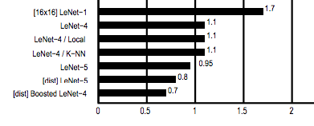
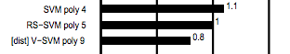
ANNs in the 90’s
SVM with polynomial kernel: 98.9 - 99.2% accurate
Custom CNN: 98.3 - 99.3% accurate

Slide 9
Nomenclature
Backpropagation: refers only to the method for computing the gradient of a function
Is NOT specific to multilayer neural networks (in principle, can compute gradients for any function)
Stochastic gradient descent: conducts learning using the derived gradient
Hence, you can run SGD on gradients you derive manually, or through backprop

Slide 10
Notation
“Borrowing” from
William Cohen at Carnegie Mellon (author of SSL algorithm you implemented in HW3)
Michael Nielson of http://neuralnetworksanddeeplearning.com/

Slide 11
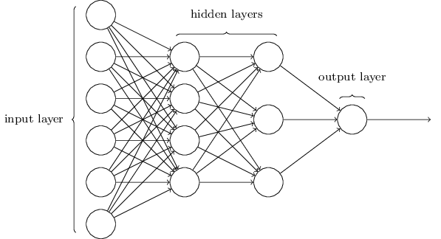
Notation

Slide 12
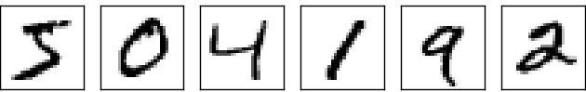
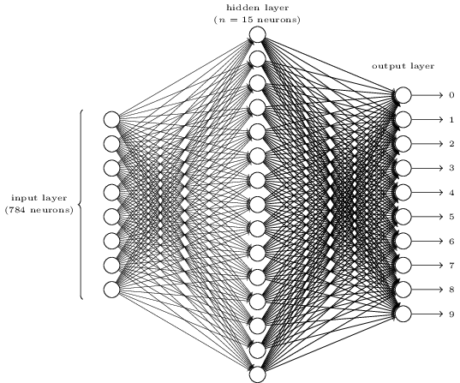
Notation
Each digit is 28x28 = 784 dimensions / inputs

Slide 13
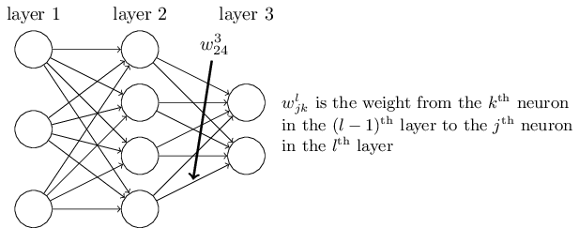
Notation
Vectorize: w^{l} is the weight matrix for layer l

Slide 14
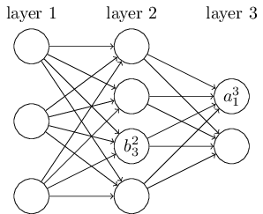
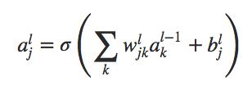
Notation
Activation
Vectorize: a^{l} and b^{l} are activations and bias matrices for layer l
Bias

Slide 15
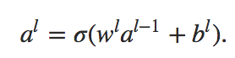
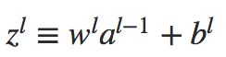
Notation
Notes:
al_j = activations for node j in lth layer
al = activations for all nodes in lth layer (and bias)
zl = the linear sum that goes into the activation

Slide 16
Computation is “feedforward”
for l=1, 2, … L:

Slide 17
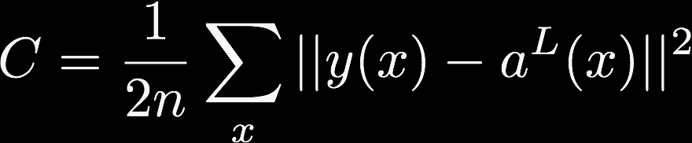
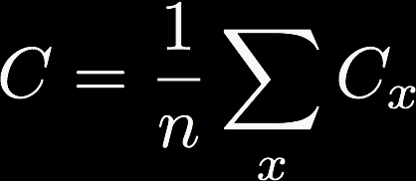
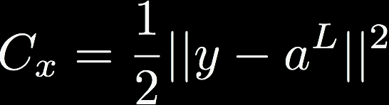
Notation
Set up a cost function, C
Rewrite as an average
where
Allows us to compute partial derivatives dC_{x}/dw and dC_{x}/db for single training examples, then recover dC/dw and dC/db by averaging over training examples.
Notes:
n is number of training points x
Capital L is the final layer (ie where classification happens!)

Slide 18
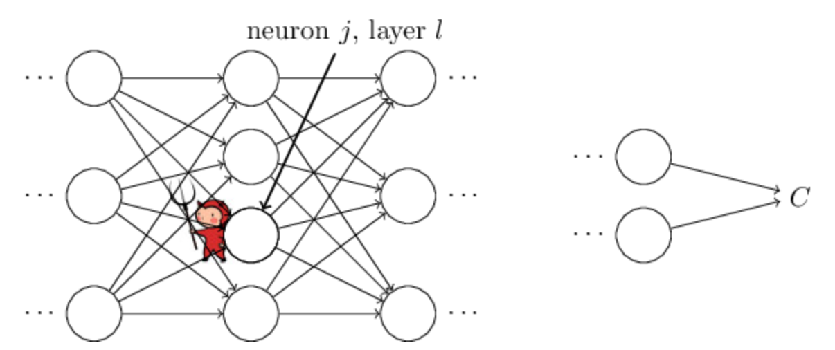
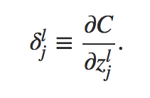
Notation
Error in j^{th} neuron at the l^{th} layer
Notes:
Imagine there is a demon in our neural network
Demon sits at the jth neuron in the lth layer
As input comes in, demon messes with the weights, adjusting it by some delta z.
–change propagates through the network resulting in an average change in the cost by (dC/dz_lj)*delta z
Demon could be a good demon! If dC/dz_lj is large, demon could choose delta z with equal magnitude but opposite sign

Slide 19
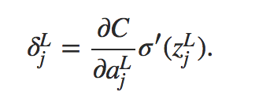
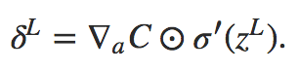
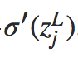
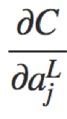
BackProp: last layer
Matrix form:
Level l for l=1,…,L
Matrix: w^{l}
Vectors:
bias b^{l}
activation a^{l}
pre-sigmoid activ: z^{l}
target output y
“local error”δ^{l}
components are
components are
The Hadamard Product: just element-wise multiplication
Notes:
First: compute the error in the very last layer (the output layer, where classification happens)

Slide 20
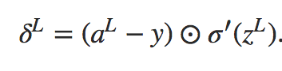
BackProp: last layer
Level l for l=1,…,L
Matrix: w^{l}
Vectors:
bias b^{l}
activation a^{l}
pre-sigmoid activ: z^{l}
target output y
“local error”δ^{l}
Matrix form for square loss:
Notes:
Specifically, for squared loss, it would look like this

Slide 21
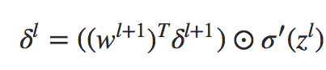
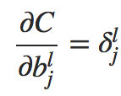
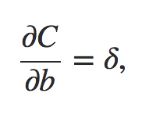
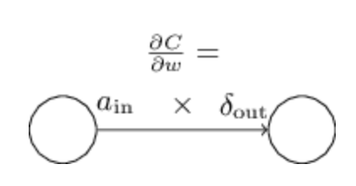
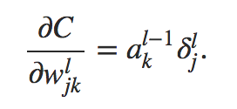
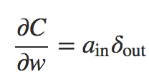
BackProp: error at level l in terms of error at level l+1
which we can use to compute
Level l for l=1,…,L
Matrix: w^{l}
Vectors:
bias b^{l}
activation a^{l}
pre-sigmoid activ: z^{l}
target output y
“local error”δ^{l}
Notes:
Now, having computed the error at layer L, we start iterating by stepping BACKWARD through the layers
At each layer l, we use the error we found at layer l + 1 to compute the error at layer l

Slide 22
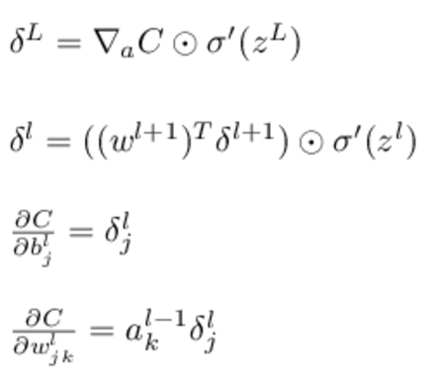
BackProp: Summary
Level l for l=1,…,L
Matrix: w^{l}
Vectors:
bias b^{l}
activation a^{l}
pre-sigmoid activ: z^{l}
target output y
“local error”δ^{l}
Notes:
And we iterate!

Slide 23
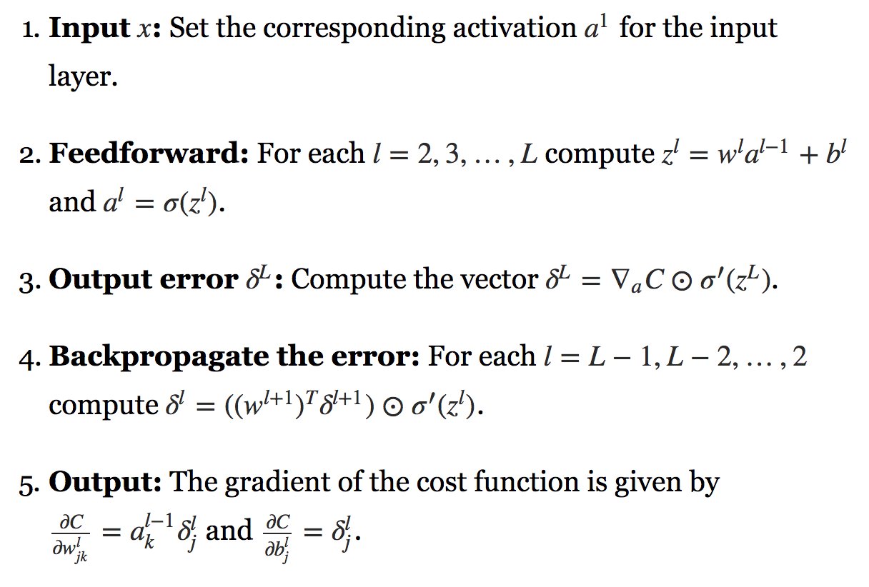
Full Backpropagation
Use SGD to update the weights according to the gradients

Slide 24

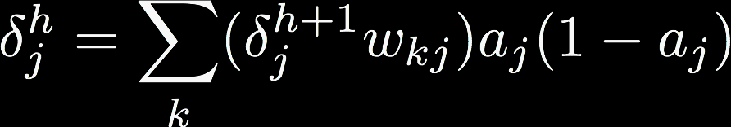
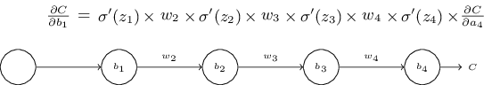
Weight updates for multilayer ANN
For nodes k in output layer L:
For nodes j in hidden layer h:
What happens as the layers get further and further from the output layer?
Notes:
“further and further from output layer” = “closer to the input layer”

Slide 25
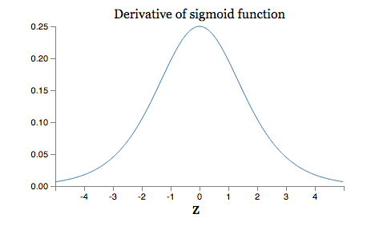
Gradients are unstable
Max at 1/4
If weights are usually < 1, and we are multiplying by many, many such numbers…
The Amazing Vanishing Gradient!
Notes:
(also the exploding gradient, but this is less common)

Slide 26
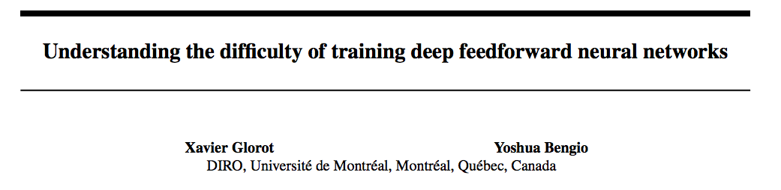
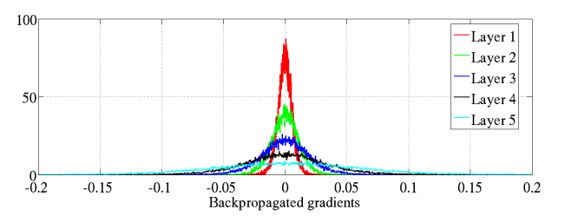
AI Stats 2010
input
output
Histogram of gradients in a 5-layer network for an artificial image recognition task
Notes:
Layer 5 (the last layer, the output layer) has a nearly-uniform spread of weights
Layer 1 (the first layer, the input layer) has weights that are almost all 0, and those that aren’t 0 are very close to 0

Slide 27
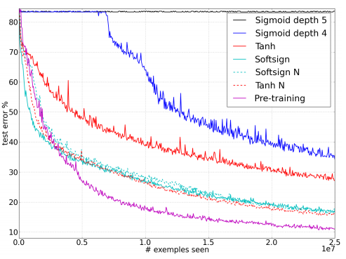
AI Stats 2010
Notes:
Sigmoid depth 4 and 5 take much, much longer to decrease in training error (due to tiny gradients)

Slide 28
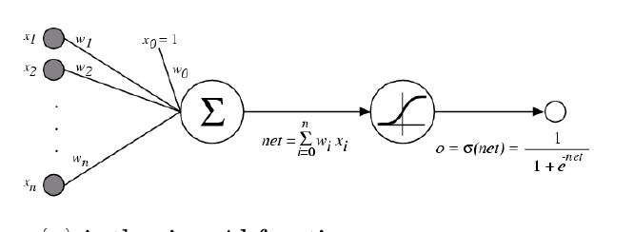
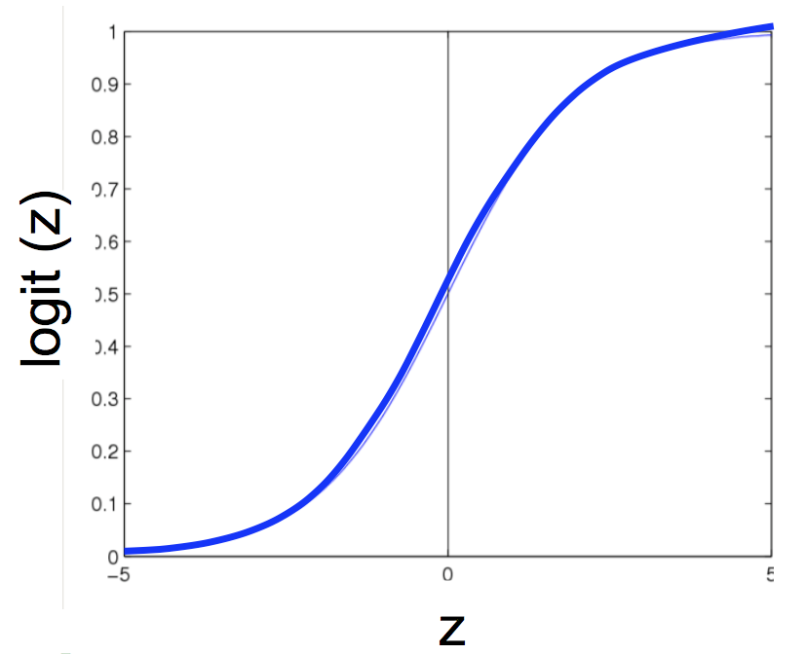
It’s easy for sigmoid units to saturate
Learning rate approaches zero, and neuron gets “stuck”

Slide 29
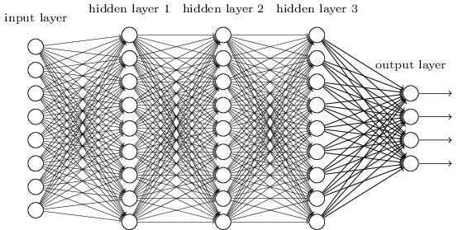
It’s easy for sigmoid units to saturate
Notes:
For a big network there are lots of weighted inputs to each neuron.
- If any of them are too large then the neuron will saturate.
So neurons get stuck with a few large inputs OR many small ones.

Slide 30

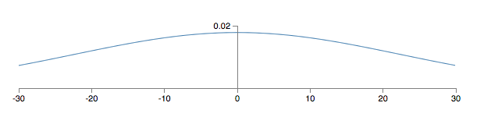
It’s easy for sigmoid units to saturate
If there are 500 non-zero inputs initialized with a Gaussian ~N(0,1) then the SD is

Slide 31
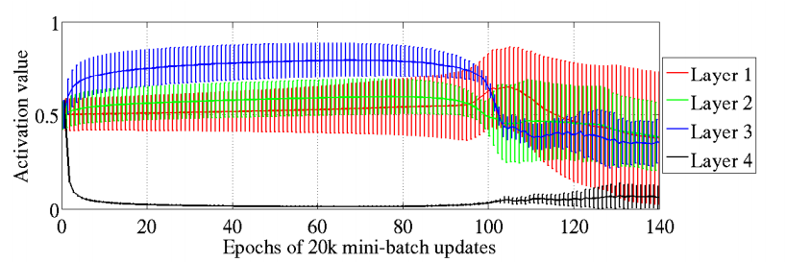
It’s easy for sigmoid units to saturate
Saturation visualization from Glorot & Bengio 2010 -- using a smarter initialization scheme
Bottom layer still stuck for first 100 epochs

Slide 32
What’s Different About Modern ANNs?

Slide 33
Some key differences
Use of softmax and entropic loss instead of quadratic (squared) loss
Use of alternate non-linearities
ReLU and hyperbolic tangent, instead of sigmoid
Better understanding of weight initialization
Data augmentation
Especially for image data
Ability to explore architectures rapidly

Slide 34
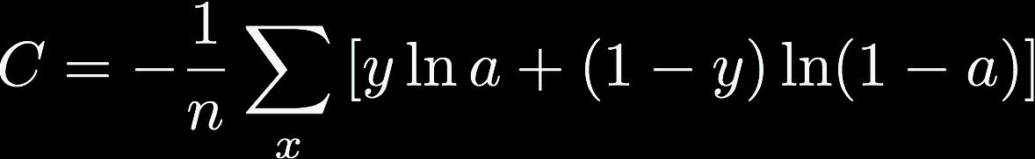
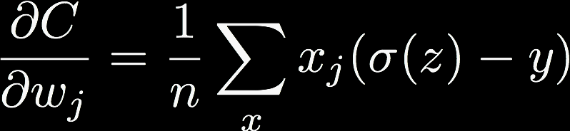
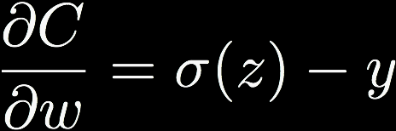
Cross-entropy loss

Slide 35
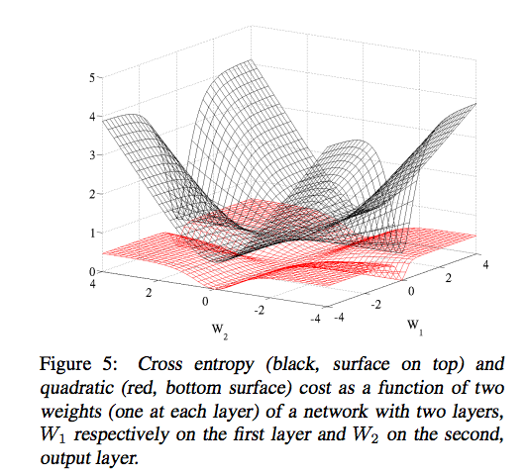
Cross-entropy loss
Notes:
Loss surface induced by the chosen loss function: notice the black (cross-entropy loss) has much larger gradients overall, meaning faster convergence, as compared to the red (squared loss)

Slide 36
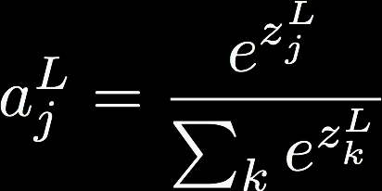
Softmax output layer
Cross-entropy loss after a softmax layer gives a very simple, numerically stable gradient: (y - a^{L})
Δw_{ij =} (y_{i}-z_{i})y _{j}
Network outputs a probability distribution!

Slide 37
Some key differences
Use of softmax and entropic loss instead of quadratic loss
Often learning is faster and more stable as well as getting better accuracies in the limit
Use of alternate non-linearities
Better understanding of weight initialization
Data augmentation
Especially for image data
Ability to explore architectures rapidly

Slide 38
Some key differences
Use of softmax and entropic loss instead of quadratic loss.
Often learning is faster and more stable as well as getting better accuracies in the limit
Use of alternate non-linearities
reLU and hyperbolic tangent
Better understanding of weight initialization
Data augmentation
Especially for image data
Ability to explore architectures rapidly

Slide 39
Alternative non-linearities
Changes so far
Changed the loss from square error to cross-entropy (no effect at test time)
Proposed adding another output layer (softmax)
A new change: modifying the nonlinearity
The logistic / sigmoid is not widely used in modern ANNs

Slide 40
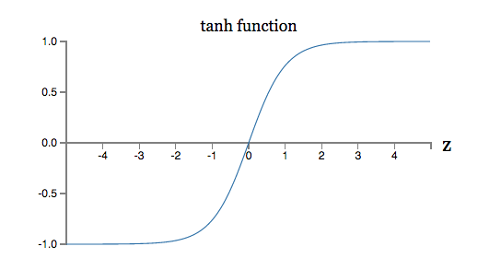
Alternative non-linearities
A new change: modifying the nonlinearity
The logistic is not widely used in modern ANNs
Alternative #1: tanh
Like logistic, but shifted to range [-1, +1]
Notes:
Tanh has a larger region of large gradients (closer to linear) than the sigmoid

Slide 41
AI Stats 2010
depth 4?

Slide 42
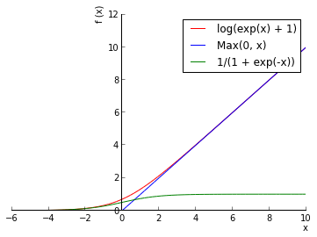


Alternative non-linearities
A new change: modifying the nonlinearity
The logistic is not widely used in modern ANNs
Alternative #1: tanh
Like logistic, but shifted to range [-1, +1]
Alternative #2: ReLU
Linear with cut-off at zero
Alternative #2.5: ”Soft” ReLU
Doesn’t saturate (at one end)
Sparsifies outputs
Helps with vanishing gradient

Slide 43
Some key differences
Use of softmax and entropic loss instead of quadratic loss.
Often learning is faster and more stable as well as getting better accuracies in the limit
Use of alternate non-linearities
reLU and hyperbolic tangent
Better understanding of weight initialization
Data augmentation
Especially for image data
Ability to explore architectures rapidly

Slide 44


It’s easy for sigmoid units to saturate
If there are 500 non-zero inputs initialized with a Gaussian ~N(0,1) then the SD is
Common heuristics for initializing weights

Slide 45


Initializing to avoid saturation
In Glorot and Bengio (2010) they suggest weights if level j (with n_{j} inputs) from
First breakthrough deep learning results were based on clever pre-training initialization schemes, where deep networks were seeded with weights learned from unsupervised strategies
This is not always the solution – but good initialization is very important for deep nets!

Slide 46
Summary
Backpropagation makes training deep neural networks possible
Known since 1970s, understood since 1980s, used since 1990s, tractable since 2010s
Feed-forward versus backward propagation
Feed-forward evaluates the network’s current configuration, J()
Backpropagation assigns error in J() to individual weights
Each layer considered a function of its inputs
Differentiable activation functions strung together
Chain rule of calculus
Modern deep architectures made possible due to logistical tweaks
Vanishing / Exploding gradient and new activation functions

Slide 47
References
“A gentle introduction to backpropagation”, http://numericinsight.com/uploads/A_Gentle_Introduction_to_Backpropagation.pdf
“Deep Feed-Forward Networks”, Chapter 6, Deep Learning Book, http://www.deeplearningbook.org/contents/mlp.html
“Backpropagation, Intuitions”, CS231n “CNNs for Visual Recognition”, https://cs231n.github.io/optimization-2/
“How the Backpropagation Algorithm works”, Chapter 2, Neural Networks and Deep Learning, http://neuralnetworksanddeeplearning.com/

Slide 49


Example
Simple equation
Some example inputs
x = -2
y = 5
z = -4
Notes:
Green values = forward propagation of network evaluation
Red values = back propagation of gradients

Slide 50


[slightly less simple] Example
2D Logistic Regression, with a bias term

